Slide 1
Exact Learning Benedict W. J. Irwin

Slide 2
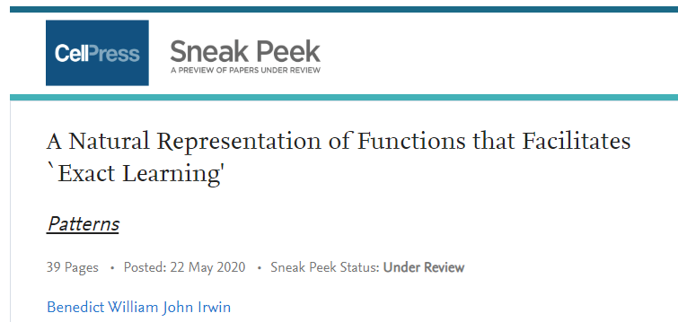
Work so far assembled into a preprint

Slide 3
Topics
What is ‘Exact Learning’?
Can we mine equations from data?
Low number of parameters
Represent real physics, chemistry, mathematics
A representation for analytic functions, 1-D and N-D
Highly Generalised Functions
Mellin Transforms
Mellin-Barnes Integrals
Machine Learning Type Applications
Examples
Future ideas
Easy
Complicated
Moderate, Speculative

Slide 4
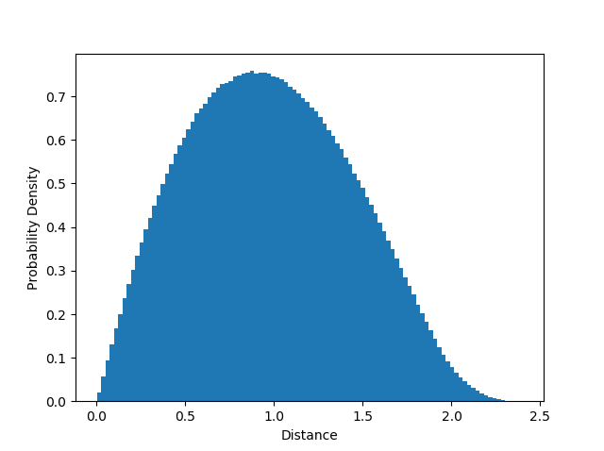
What is Exact Learning?
Many theoretical, computational and experimental studies lead to an unknown distribution/curve (potentially in higher dimensions):
Monte Carlo ‘games’
Walks on a graph
Probabilistic geometry
Statistics
Random matrices
Convolution of distributions
Solution to differential equation
Wavefunction of some potential

Slide 5
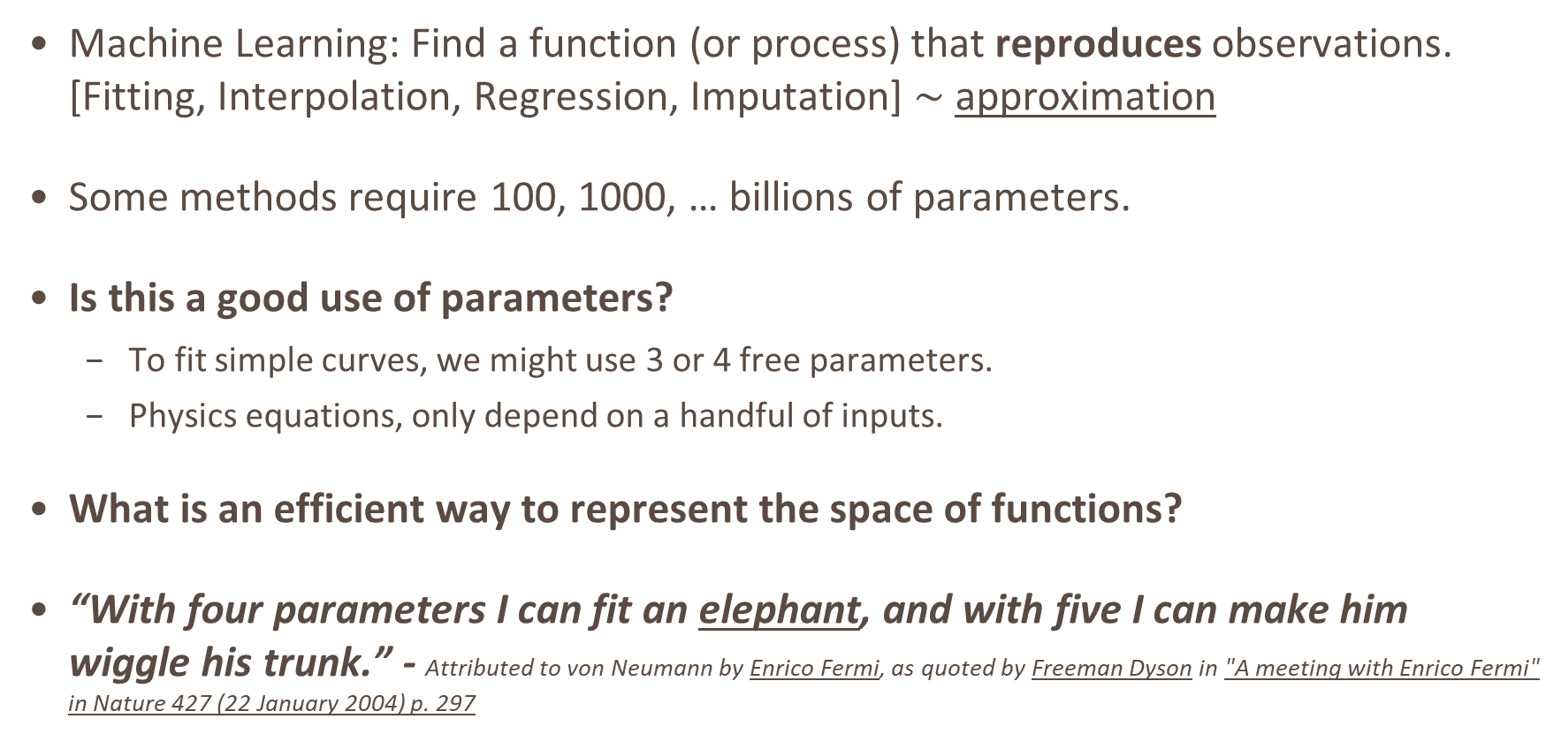
Some Thoughts on Machine Learning
Machine Learning: Find a function (or process) that reproduces observations. [Fitting, Interpolation, Regression, Imputation] $\sim$ approximation
Some methods require 100, 1000, … billions of parameters.
Is this a good use of parameters?
To fit simple curves, we might use 3 or 4 free parameters.
Physics equations, only depend on a handful of inputs.
What is an efficient way to represent the space of functions?
“With four parameters I can fit an elephant, and with five I can make him wiggle his trunk.” - Attributed to von Neumann by Enrico Fermi, as quoted by Freeman Dyson in "A meeting with Enrico Fermi" in Nature 427 (22 January 2004) p. 297

Slide 6
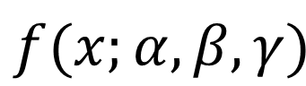
Have you ever tried to “Guess the Curve”?
Can throw equations with free variables into [gnuplot, python, Mathematica, …]
Scientific data:
Good chance the curve exactly follows an equation, (depending on the underlying model)
Solve once, learn forever, across the entire domain -> ‘Natural Facts’
Instead train a machine to ‘guess the curve’
What is a good way to go about this?
$$f(x;α,β,γ)$$

Slide 7
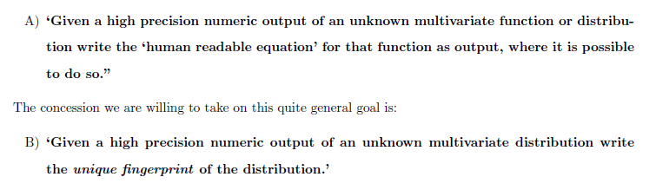
Exact Learning

Slide 8
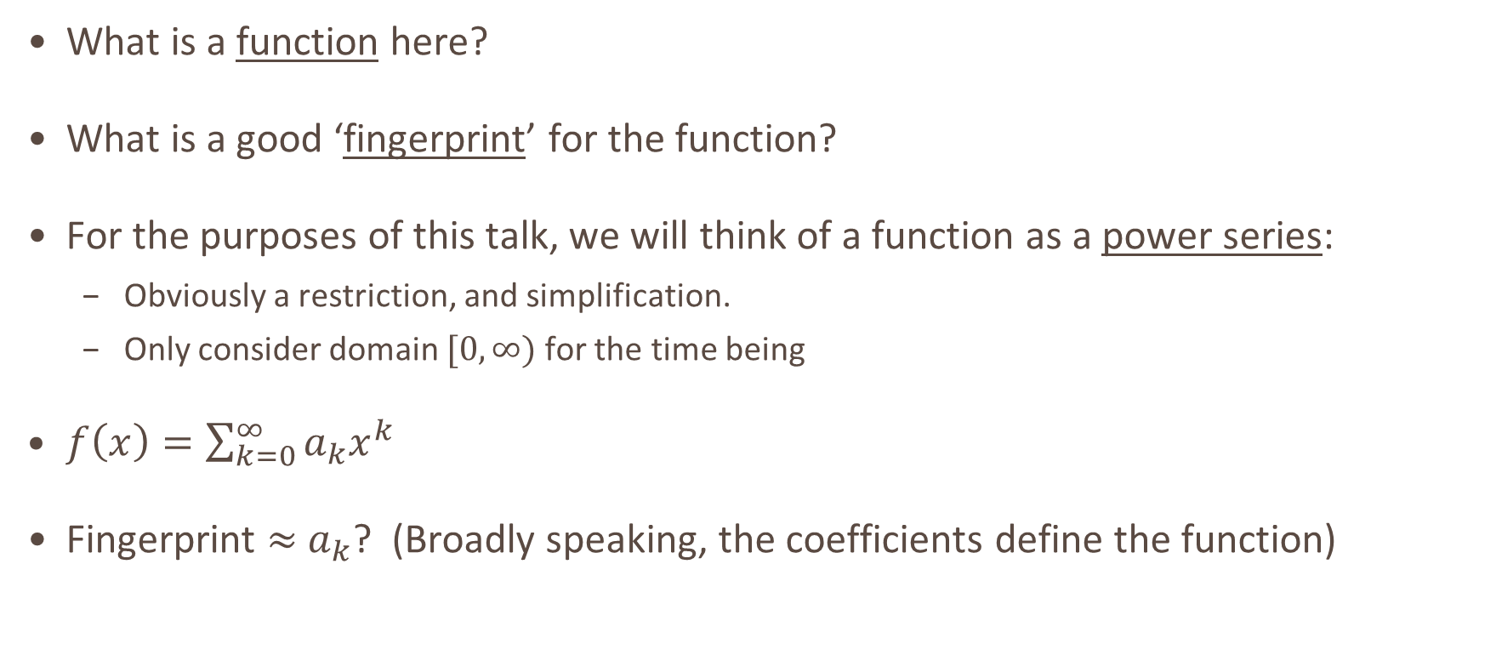
Some Representational Points
What is a function here?
What is a good ‘fingerprint’ for the function?
For the purposes of this talk, we will think of a function as a power series:
Obviously a restriction, and simplification.
Only consider domain $[0,∞)$ for the time being
$f\left(x\right)=\sum_{k=0}^{∞}{a_{k}x^{k}}$
Fingerprint $≈$ $a_{k}$? (Broadly speaking, the coefficients define the function)

Slide 9
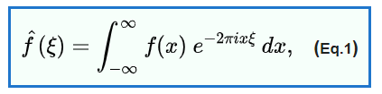
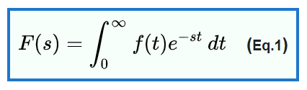
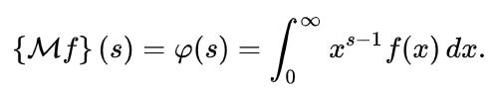
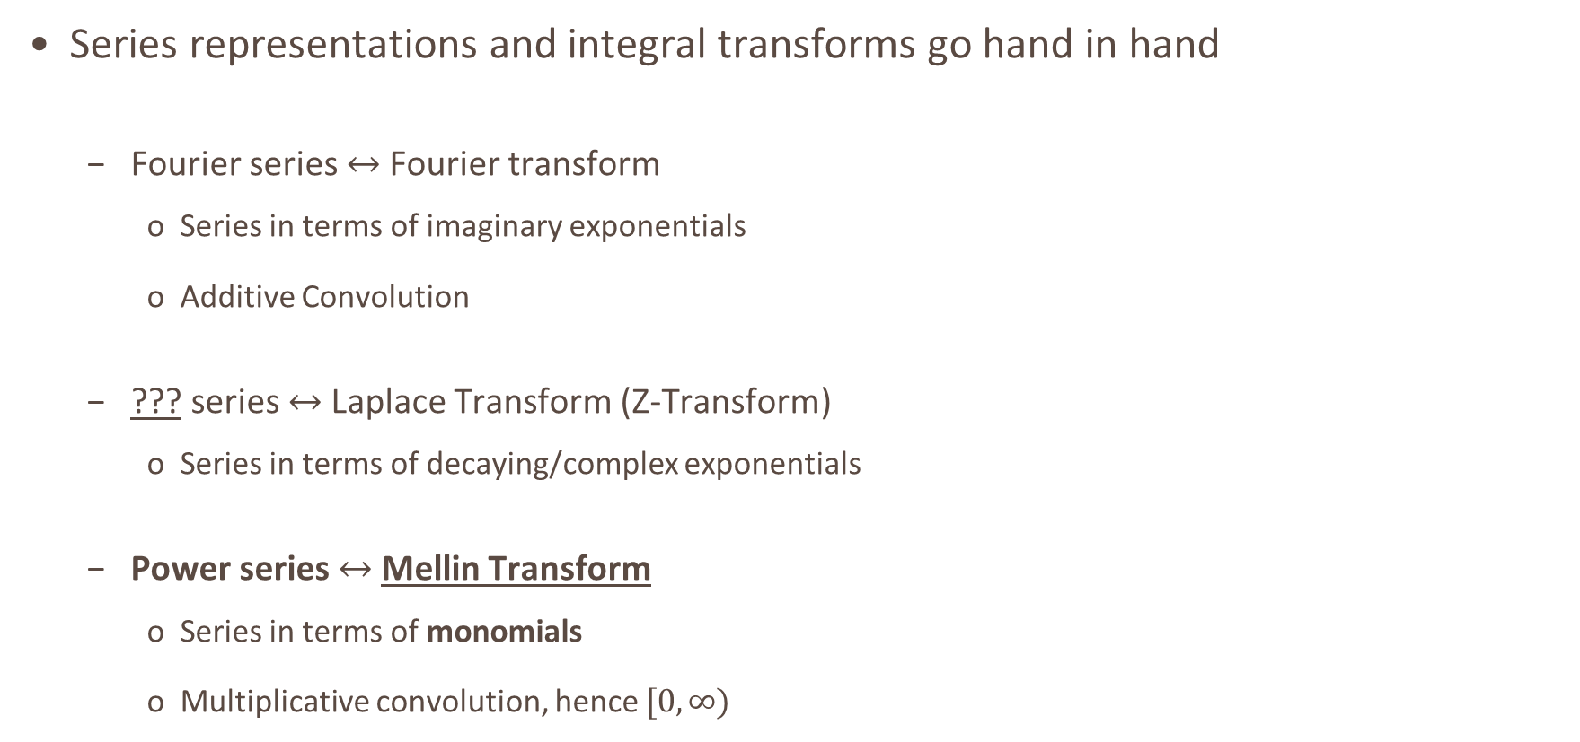
Transforms and Coefficients
Series representations and integral transforms go hand in hand
Fourier series $↔$ Fourier transform
Series in terms of imaginary exponentials
Additive Convolution
??? series $↔$ Laplace Transform (Z-Transform)
Series in terms of decaying/complex exponentials
Power series $↔$ Mellin Transform
Series in terms of monomials
Multiplicative convolution, hence $[0,∞)$

Slide 10
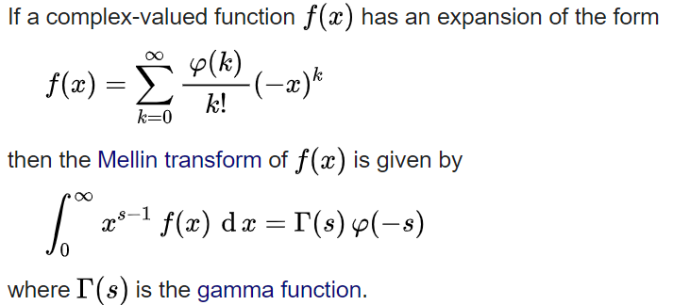
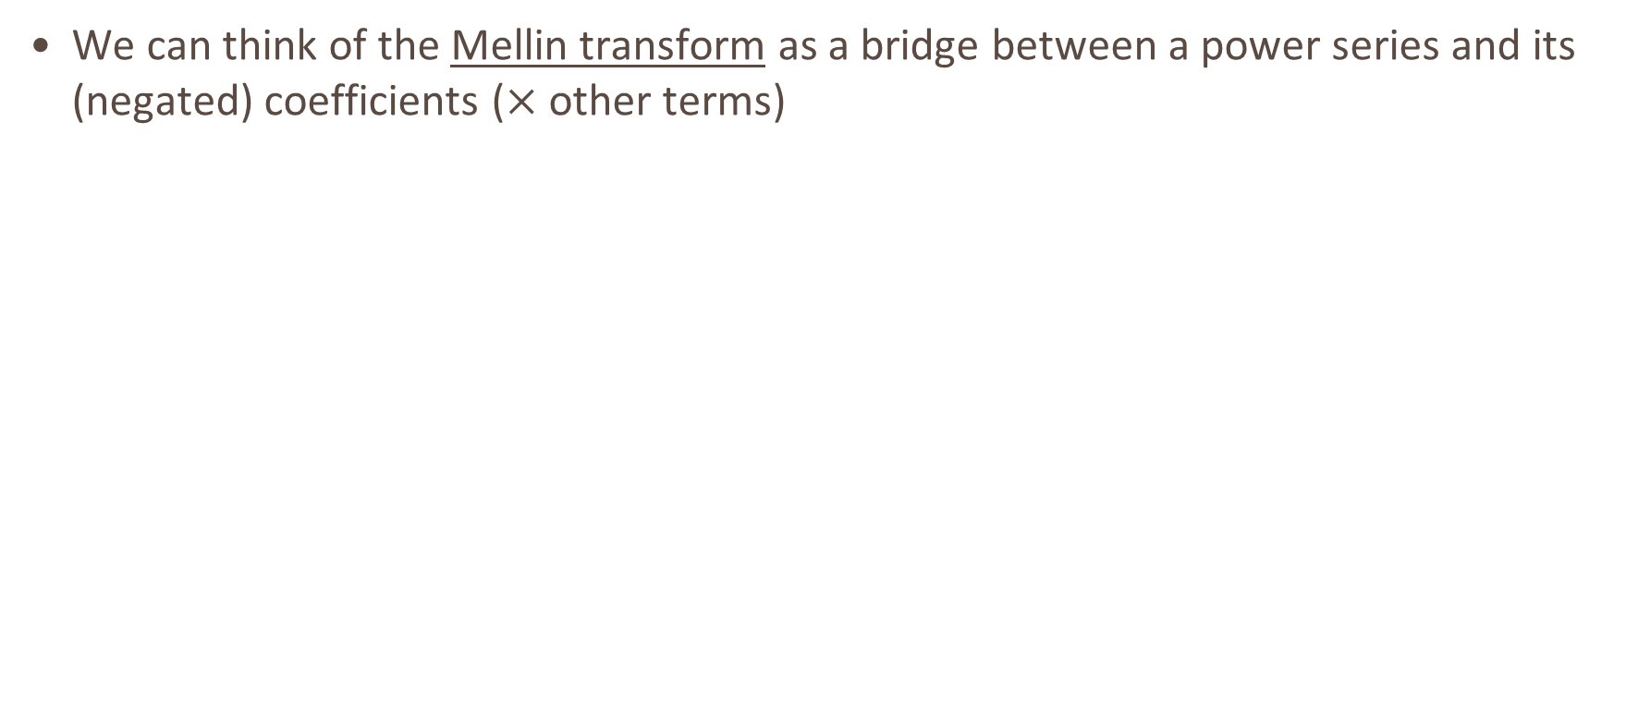
Ramanujan Master Theorem
We can think of the Mellin transform as a bridge between a power series and its (negated) coefficients ($×$ other terms)
Over Integers
Over complex plane… Analytic Continuation

Slide 11
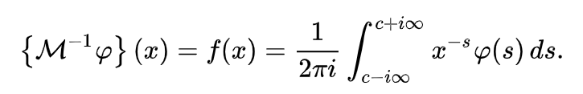
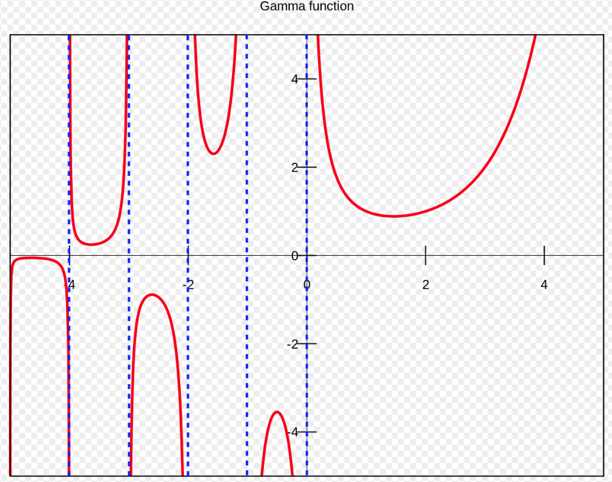
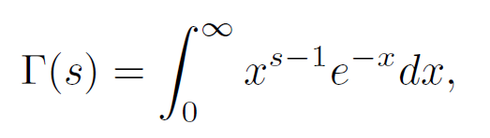
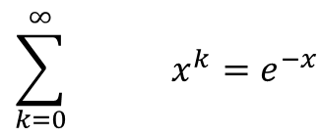

Inverse Mellin Transform
We can go the other way
We ‘sum over the residues’ of an infinite contour
Overly formal: Just sum the coefficients.
Notice the Gamma function appears often
Poles in the negative integers
$$\sum_{k=0}^{∞}{ x^{k}=e^{−x}}$$
$$\frac{{\left(−1\right)}^{k}}{k!}$$

Slide 12
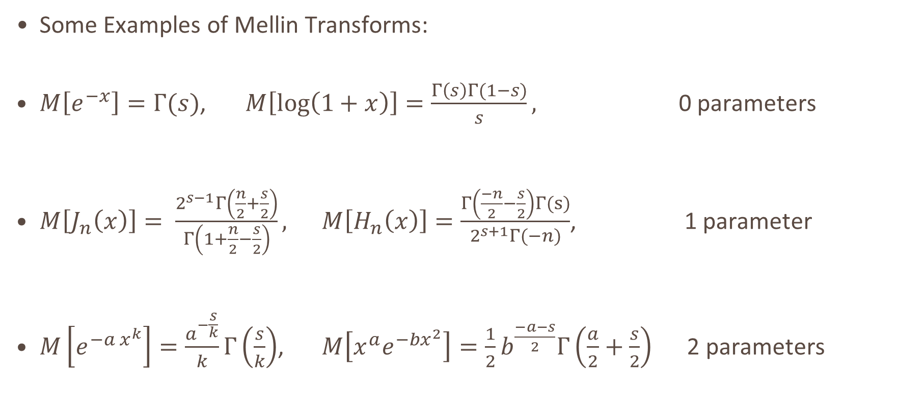
Examples – 1D - Mellin Transform
Some Examples of Mellin Transforms:
$M\left[e^{−x}\right]=Γ(s)$, $M\left[log\left(1+x\right)\right]=\frac{Γ\left(s\right)Γ(1−s)}{s},$ 0 parameters
$M\left[J_{n}\left(x\right)\right]= \frac{2^{s−1}Γ\left(\frac{n}{2}+\frac{s}{2}\right)}{Γ\left(1+\frac{n}{2}−\frac{s}{2}\right)},$ $M\left[H_{n}\left(x\right)\right]=\frac{Γ\left(\frac{−n}{2}−\frac{s}{2}\right)Γ(s)}{2^{s+1}Γ(−n)}$, 1 parameter
$M\left[e^{−a x^{k}}\right]=\frac{a^{−\frac{s}{k}}}{k}Γ\left(\frac{s}{k}\right)$, $M\left[x^{a}e^{−bx^{2}}\right]=\frac{1}{2}b^{\frac{−a−s}{2}}Γ\left(\frac{a}{2}+\frac{s}{2}\right)$ 2 parameters

Slide 13
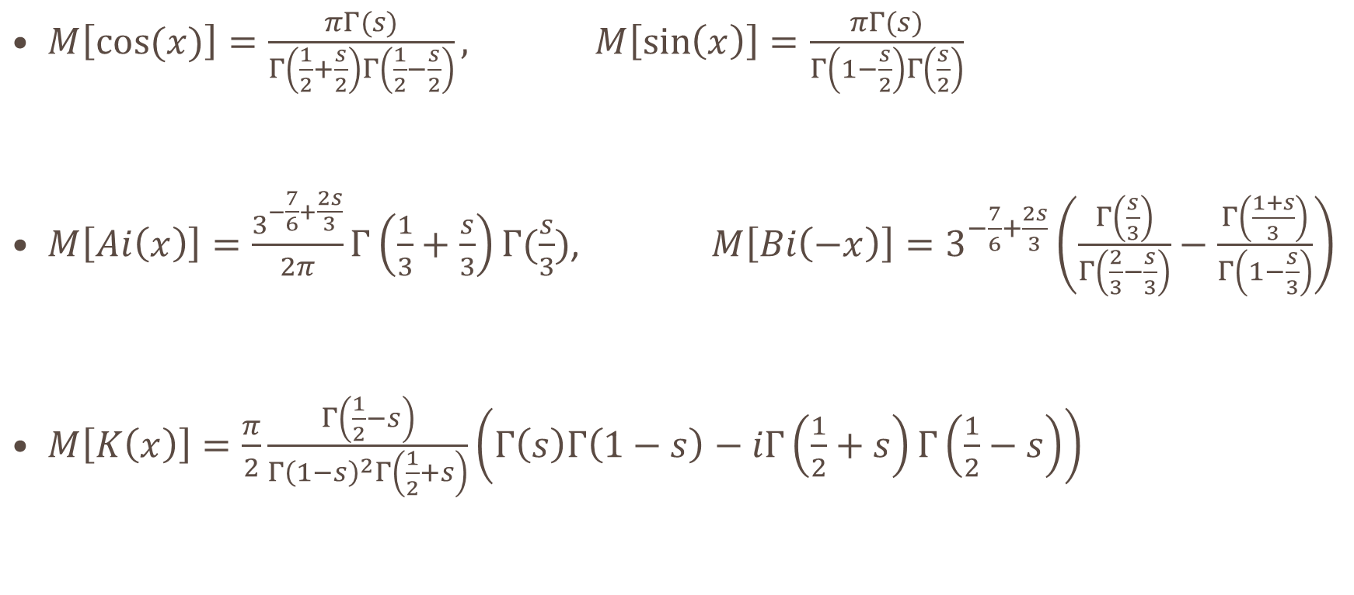
Further Examples : Diverse Range of Functions
$M\left[\cos{(x)}\right]=\frac{πΓ(s)}{Γ\left(\frac{1}{2}+\frac{s}{2}\right)Γ\left(\frac{1}{2}−\frac{s}{2}\right)},$ $M\left[\sin\left(x\right)\right]=\frac{πΓ(s)}{Γ\left(1−\frac{s}{2}\right)Γ\left(\frac{s}{2}\right)}$
$M\left[Ai\left(x\right)\right]=\frac{3^{−\frac{7}{6}+\frac{2s}{3}}}{2π}Γ\left(\frac{1}{3}+\frac{s}{3}\right)Γ(\frac{s}{3})$, $M\left[Bi\left(−x\right)\right]=3^{−\frac{7}{6}+\frac{2s}{3}}\left(\frac{Γ\left(\frac{s}{3}\right)}{Γ\left(\frac{2}{3}−\frac{s}{3}\right)}−\frac{Γ\left(\frac{1+s}{3}\right)}{Γ\left(1−\frac{s}{3}\right)}\right)$
$M\left[K\left(x\right)\right]=\frac{π}{2}\frac{Γ\left(\frac{1}{2}−s\right)}{Γ{\left(1−s\right)}^{2}Γ\left(\frac{1}{2}+s\right)}\left(Γ\left(s\right)Γ\left(1−s\right)−iΓ\left(\frac{1}{2}+s\right)Γ\left(\frac{1}{2}−s\right)\right)$
Airy Functions
Elliptic K function

Slide 14
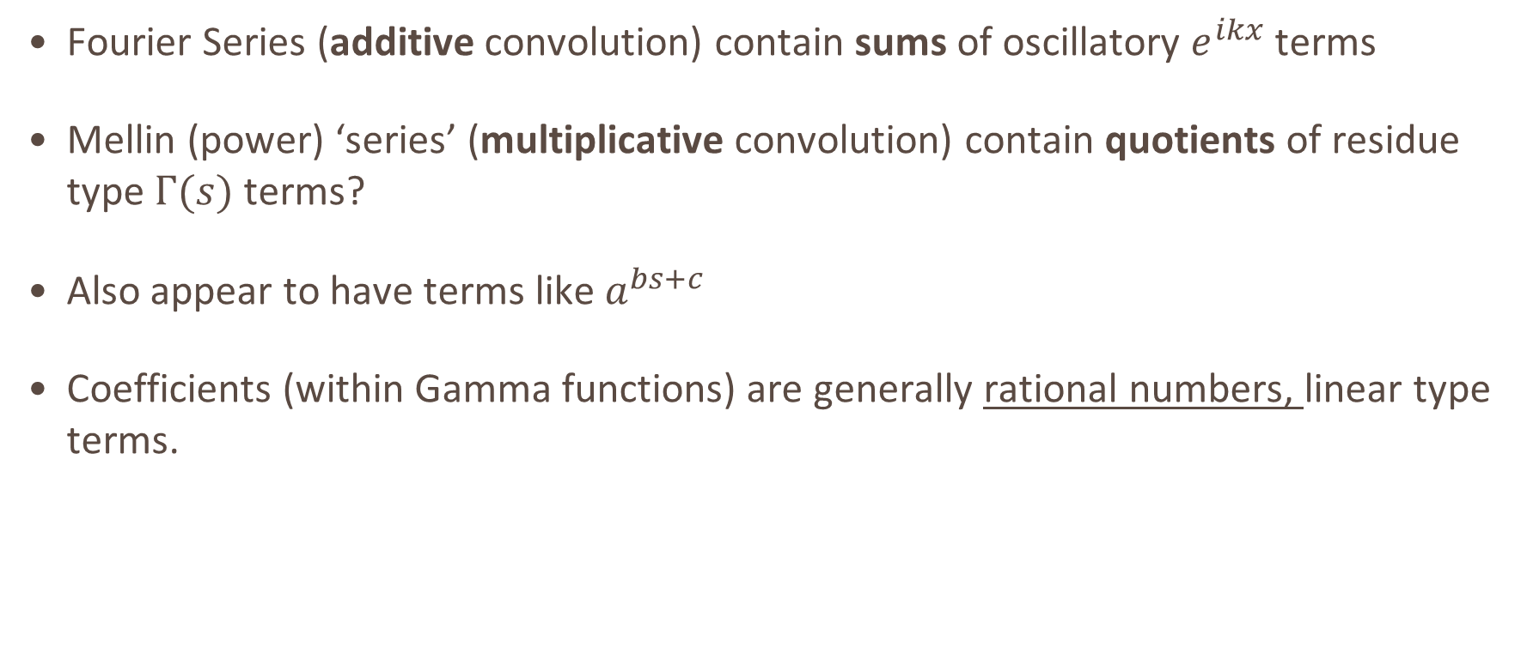
Observations
Fourier Series (additive convolution) contain sums of oscillatory $e^{ikx}$ terms
Mellin (power) ‘series’ (multiplicative convolution) contain quotients of residue type $Γ(s)$ terms?
Also appear to have terms like $a^{bs+c}$
Coefficients (within Gamma functions) are generally rational numbers, linear type terms.

Slide 15
Our Goal – One Function to Rule them all
Make a function that can become all ‘lesser’ functions with only a few parameters
When we ‘fit’ or ‘machine-learn’ the function, we want our representation to be flexible enough to cover any analytic ‘special function’, but not completely arbitrary e.g. neural network.
Retains the ‘exactness’
The ‘Mellin space’ (or moments-space), seems more regular than the original domain.
Good news everybody!
The problem was solved hundreds of years ago by Euler

Slide 16
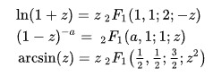
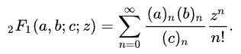
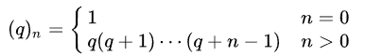
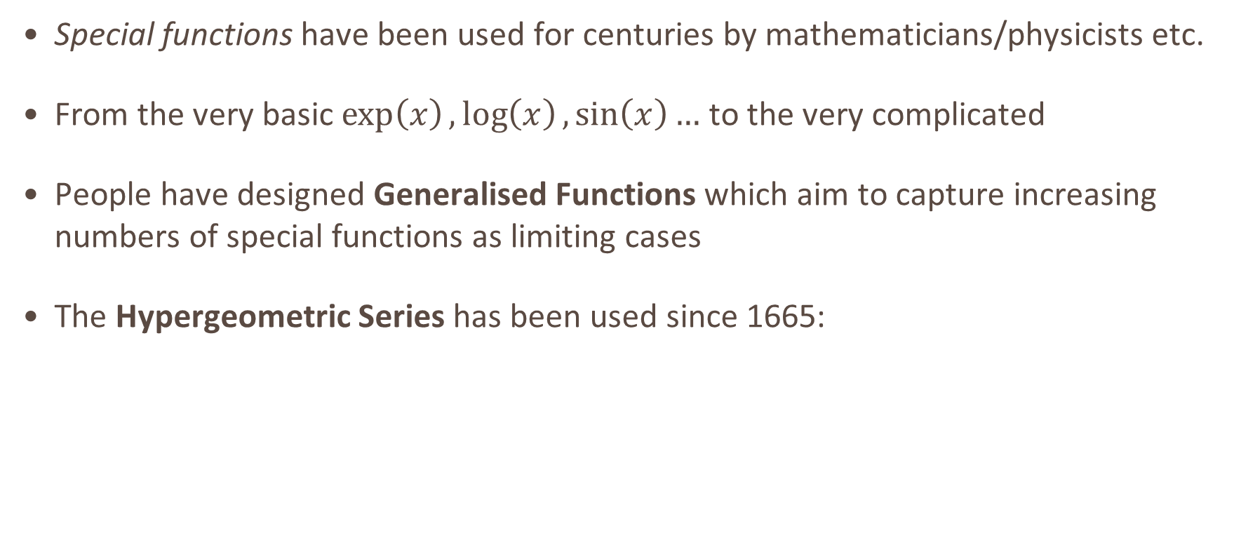
Highly Generalised Functions: Some History
Special functions have been used for centuries by mathematicians/physicists etc.
From the very basic $\exp\left(x\right),\log\left(x\right),\sin\left(x\right)…$ to the very complicated
People have designed Generalised Functions which aim to capture increasing numbers of special functions as limiting cases
The Hypergeometric Series has been used since 1665:

Slide 17
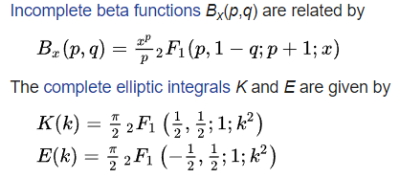
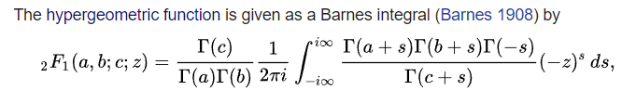
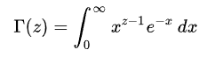
Hypergeometric Series
The series can be written as a contour integral (Barnes)
Notice the Euler Gamma function appears often
Poles in the negative axis
If you look closely, this is similar to an inverse Mellin Transform!

Slide 18
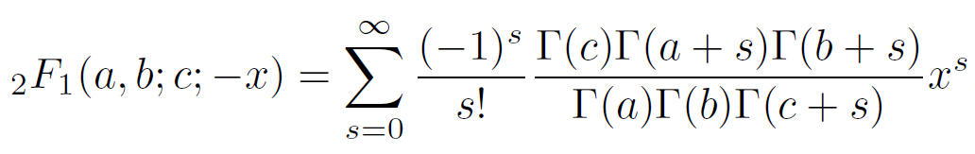
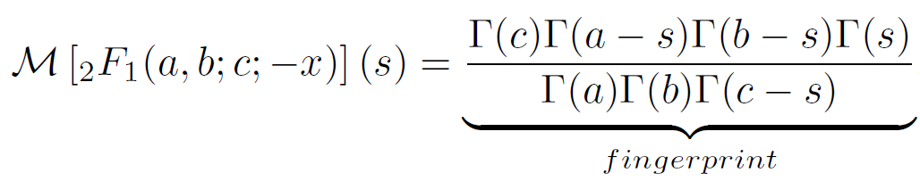
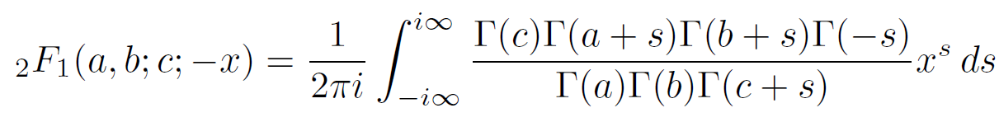
Mellin Transform
We define the Mellin Transform as :
Found this to be the most convenient part for machine learning type applications

Slide 19
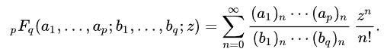
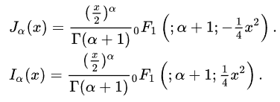
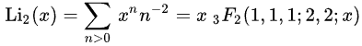
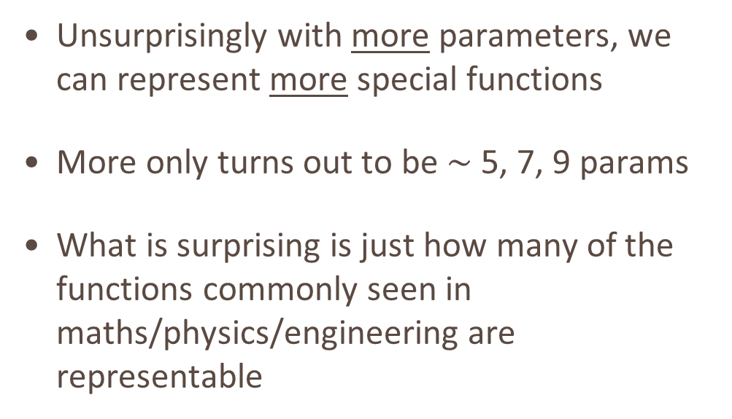
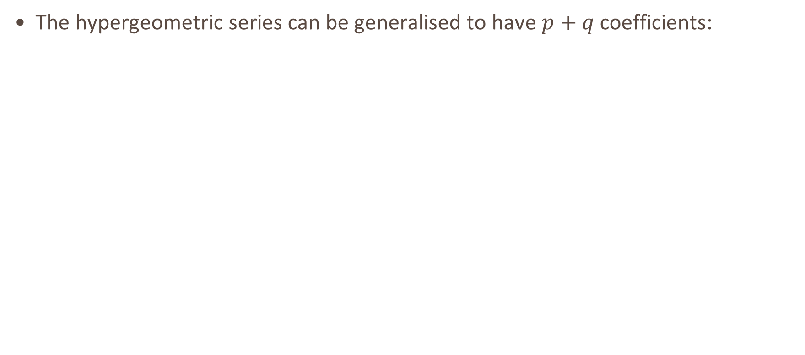
Generalised Hypergeometric Series
The hypergeometric series can be generalised to have $p+q$ coefficients:
Unsurprisingly with more parameters, we can represent more special functions
More only turns out to be $∼$ 5, 7, 9 params
What is surprising is just how many of the functions commonly seen in maths/physics/engineering are representable

Slide 20
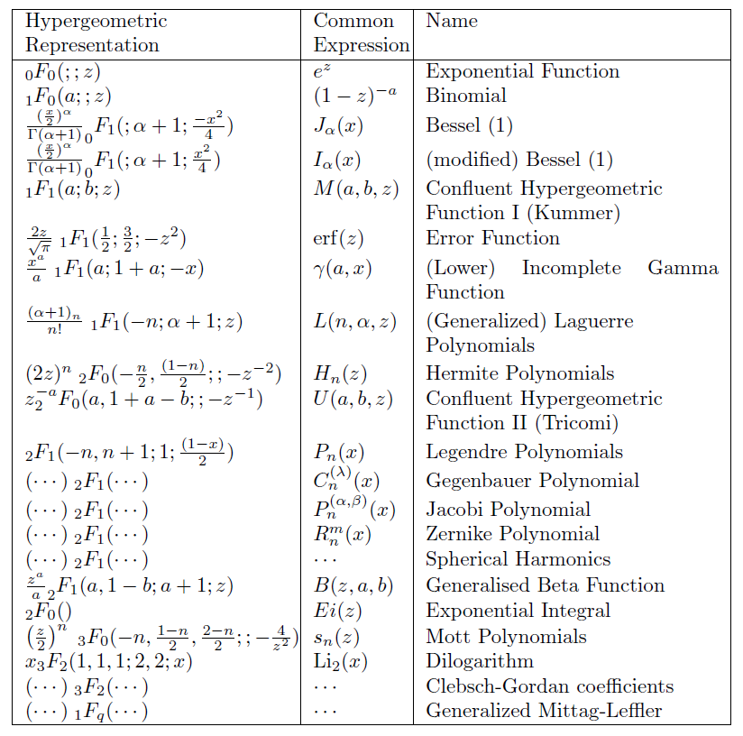
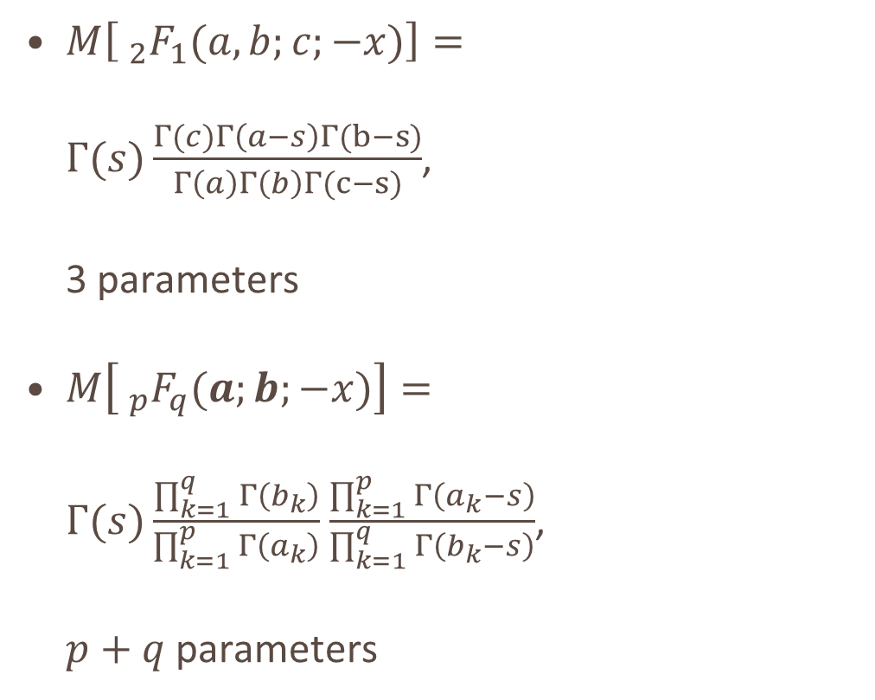
Examples – 1D Mellin Transform
$M\left[ _{2}F_{1}(a,b;c;−x)\right]=$ $Γ(s)\frac{Γ(c)Γ\left(a−s\right)Γ(b−s)}{Γ\left(a\right)Γ\left(b\right)Γ(c−s)}$, 3 parameters
$M\left[ _{p}F_{q}(a;b;−x)\right]=$ $Γ(s)\frac{\prod_{k=1}^{q}{Γ\left(b_{k}\right)}}{\prod_{k=1}^{p}{Γ\left(a_{k}\right)}}$ $\frac{\prod_{k=1}^{p}{Γ\left(a_{k}−s\right)}}{\prod_{k=1}^{q}{Γ\left(b_{k}−s\right)}}$, $p+q$ parameters

Slide 21
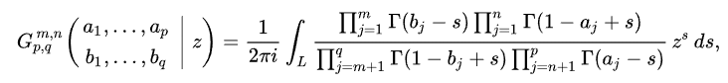
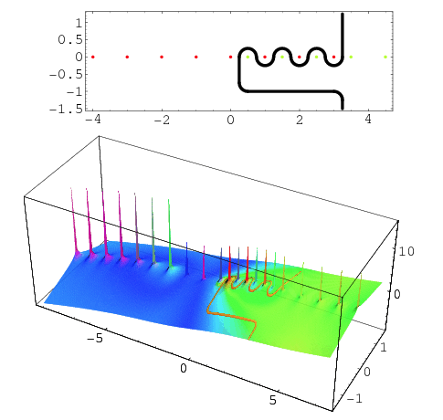
Meijer-G Function
Meijer-G function further generalises:

Slide 22
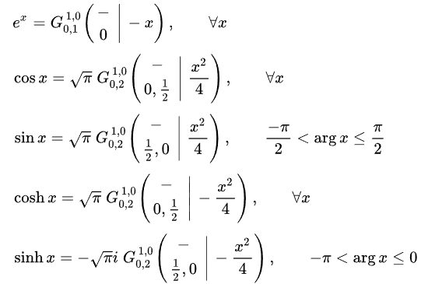
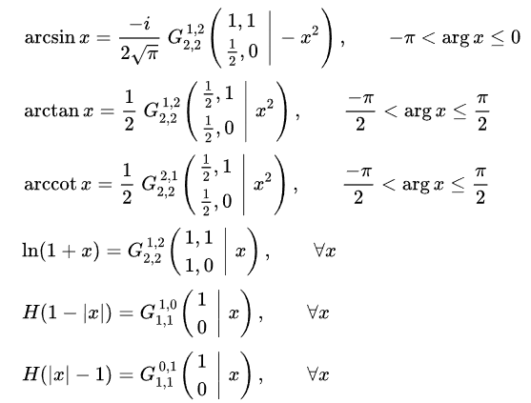
Meijer-G Function

Slide 23
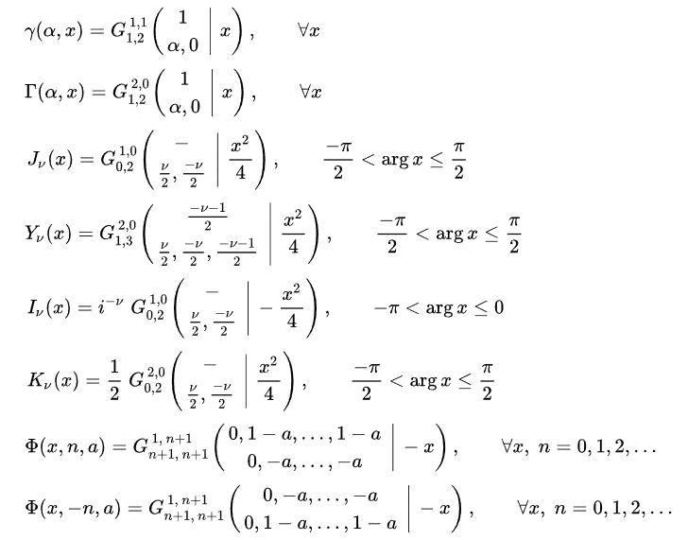
Very powerful functions are special cases.
There are also all the unnamed intermediate functions!

Slide 24
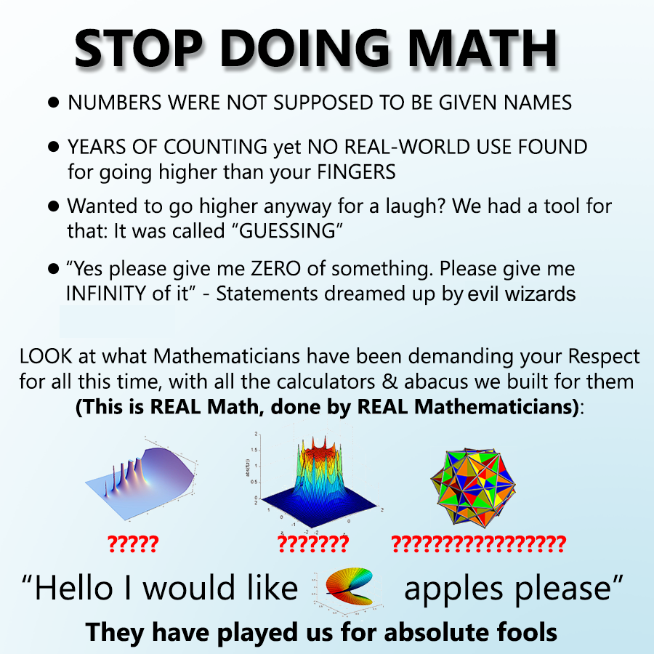
Fox-H function : It keeps going…
By adding only tens of parameters in this way we rapidly expand the space of all functions representable.
We have a fully analytic form…

Slide 25
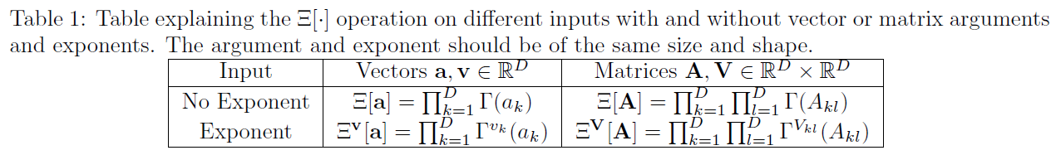
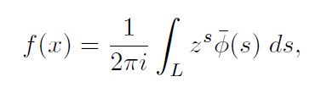
A Whole Hierarchy of Functions

Slide 26
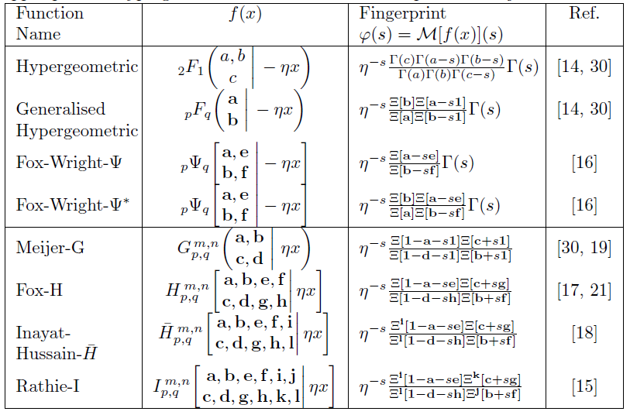
A Whole Hierarchy of Functions
Shift scalar
Shift vector
Shift + Scale
Shift + Scale
Shift + Scale + Power

Slide 27
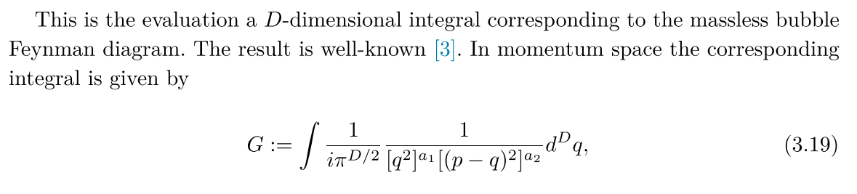
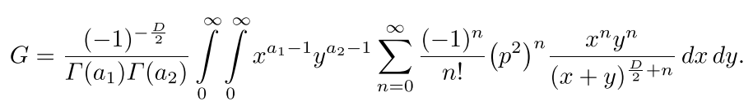
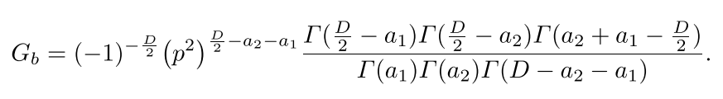
Multiple Dimensions

Slide 28
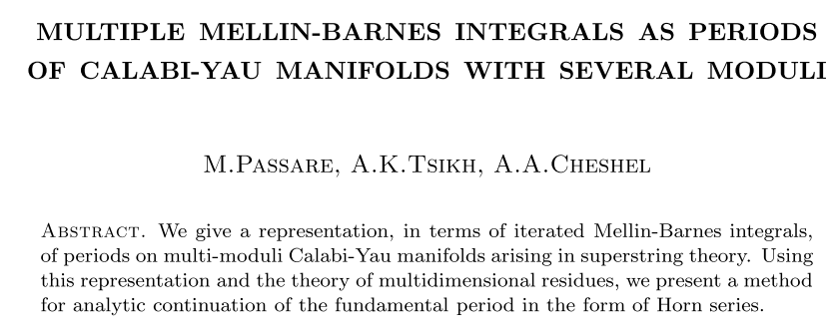
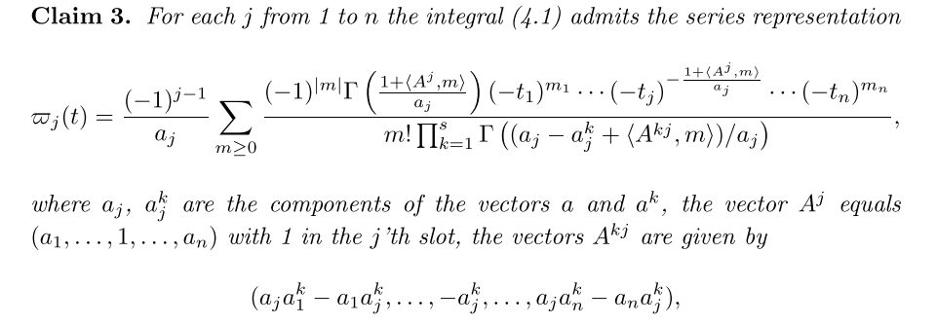
Multiple Dimensions

Slide 29


Generalised Ramanujan Master Theorem

Slide 30


Machine Learning
Unknown function, we only have data
Samples/Datapoints $x_{i}$
Application: Infer a probability distribution
Numerical Mellin transform (can use a complex parameter $s$ $∈$ $\{s_{k}\}$)
If functions are of suitably high quality, can perform numerical integration etc.

Slide 31

Exact Learning : How does it work?

Slide 32



Applications
Assume the log-moments are described by a weighted linear combination of log Gamma functions
Compare this to a neural network, i.e. a ‘log-Gamma activation function’

Slide 33

Neural Network Picture
Question: If I train a neural network to predict $\log{E[x_{1}^{s_{1}−1}x_{2}^{s_{2}−1}⋯x_{n}^{s_{n}−1}]}$ over my data, for any input vector $s$…
Will the weights in that network in anyway resemble the linear terms in the gamma functions?
Is it therefore possible to reconstruct the series representation of a function from the weights a biases of the network?
Is the underlying multivariate function, the joint probability distribution of sample points?

Slide 34

Complex Fitting – Not a Desirable Activation Function
There are numerous constraints that we have glossed over

Slide 35

Complex Fitting: Gradients?
(Compact) analytic expression for the order-n gradients:
Log Gamma functions available in tensorflow are lacking, not made for complex work, merely preventing overflow. Lack of complex ready polygamma function in python packages, mpmath

Slide 36


Example: Harmonic Oscillator, 4th Excited State
Numerically Solve
Numerically Interpolate
Numerically Integrate
Apply Exact Learning
$$φ\left(s\right)=α β^{s}\left(1−γs+δs^{2}\right)Γ\left(εs+ζ\right)$$
Take R.H.S data

Slide 37


Fitting in Complex Space

Slide 38


Example: Harmonic Oscillator
$$φ\left(s\right)=A{\sqrt{2}}^{s}\left(1−\frac{4s}{3}+\frac{4s^{2}}{3}\right)Γ\left(\frac{s}{2}\right)$$
$$\sum_{k=0}^{∞}{\frac{{\left(−1\right)}^{k}}{k!}\frac{φ(−s)}{Γ(−s)}x^{k}=Ae^{−\frac{x^{2}}{2}}H_{4}(x)}$$

Slide 39



Branch Cut Example
2$π$
2$π$

Slide 40

Other Examples that have Worked
Fits ‘Wigner’s Surmise’ – Random Matrix Theory
Many trivial examples, testing
Some integration problems

Slide 41
Work so far assembled into a preprint

Slide 42

Current Observations
Can fit with only $\sim 10$ complex number $s$ samples
Many distributions only require 3 or 4 (log)gamma functions
Have successfully fitted some functions with only two data points
Arguments of gamma functions are generally rational numbers
Use a tree to lookup neighbours to BFGS solution
Try permutations and loss will drop to machine epsilon/data epsilon if exact.
General engineering challenges
Have tried a Gaussian Process to find parameters (not great), BFGS best so far

Slide 43

Future Ideas
Fitting a function with only a ‘window of data’.
Strategies for this.
Extensions to wider domains
‘Deep Exact Learning’
Functional Series (Neumann, Volterra, etc. )

Slide 44



“Deep” Exact Learning
We have:
Functions whose moments are $Γ$-like
Functions whose moments are functions whose moments are $Γ$-like
Functions whose moments are (functions whose moments are)² $Γ$-like
Functions whose moments are (functions whose moments are)^{n} $Γ$-like

Slide 45













Elements : The Periodic Table of Moments
$$Γ(s)$$
$$Γ^{−1}(s)$$
$$πcsc\left(\frac{πs}{2}\right)=Γ\left(s\right)Γ(1−s)$$
$$ζ(s)$$
$$ψ_{0}(s)$$
$$Γ(a+s)$$
$$Γ^{−1}(a+s)$$
$$ζ(a+s)$$
$$\frac{π}{a}csc\left(\frac{πs}{2a}\right)$$
$$Γ(as)$$
$$Γ^{−1}(as)$$
$$Γ(as+b)$$
$$Γ^{−1}(as+b)$$
Polynomial Terms…

Slide 46

Irwin Master Theorem

Slide 47


Slide 48
Examples

